Slide 1
ALTERNATIVE FUELS
INFRASTRUCTURE FACILITY
AFIF
Date xx, yy, zzzz
Transport Investment,
DG MOVE, European Commission

Slide 2

Objectives
Eligible activities
Budget
Features & processes
Financing & IPs
Timetables and deadlines

Slide 3

Objective
GREEN DEAL
“calls for a 90% reduction in greenhouse gas (GHG) emissions in transport, the aim being for the EU to become a climate-neutral economy by 2050, while also working towards a zero-pollution ambition”
EUROPEAN CLIMATE LAW
“to reduce net emissions of greenhouse gases by at least 55% by 2030 compared to 1990”
SUSTAINABLE AND SMART MOBILITY STRATEGY (SSMS) communication
“Boosting the uptake of zero- and low-emission vehicles, vessels and aeroplanes and of renewable and low-carbon fuels in all modes of transport”
“by 2025, (…) half of the 1 000 hydrogen stations and 1 million out of 3 million public recharging needed by 2030”
FITFOR55 – incl. ALTERNATIVE FUELS INFRASTRUTURE REGULATION PROPOSAL (AFIR)

Slide 4
2. Eligible activities
AFIF – UNIT COSTS
AFIF – ZERO EMISSION %
AFIF – LOW EMISSION %
Publicly accessible recharging stations dedicated
  To LDV with a min power output of 150 kW.
  to HDV with a min power output of 350 kW.
Grid connection with a min power capacity of 600kVA.
Electricity recharging stations supplying public transport in TEN-T Urban Nodes; IWW & maritime vessels; port vehicles & equipment; airport ground operations
Hydrogen Refuelling Stations (HRS) for LDV and/ or long haul HDV; for public transport; IWW & maritime vessels; port vehicles & equipment; railways
LNG refuelling stations supplying inland waterway and maritime vessels

Slide 5


AFIF – UNIT CONTRIBUTIONS
Electric Charging points |  |  |  | Grid connection
Min 150 kW |  | Min 350 kW |  | Grid connection
Gen Env | CF Env | Gen Env | CF Env | Gen Env | CF Env
20.000 € | 30.000 € | 40.000 € | 60.000 € | 20.000 € | 30.000 €
Publicly accessible recharging stations along the TEN-T road network:
    Infrastructure dedicated to
    LDV with a minimum power output of 150 kW
    HVD with a minimum power output of 350 kW
    Grid connection with a minimum power capacity of 600kVA.

Slide 6
    Locations
    On TEN-T road sections identified in the 2 “eligibility maps”:
    150 kW and above (incl. > 350 kW) & 350 kW https://ec.europa.eu/transport/infrastructure/tentec/tentec-portal/map/docs/AFIF1_2_150kw_350kw.pdf
    A buffer of 2km driving distance from the TEN-T road network is applicable, calculated from the closest exit.
Simulation Zoom : TENtec Public Viewer
http://ec.europa.eu/transport/infrastructure/tentec/tentec-portal/map/maps.html
Green: Non-eligible
Red: Eligible
Update of the maps:
Cut-off dates |  | MAPS
AFIF – 1 | 19 January 2022 | Version 1 of the MAPs | Published on 15/09/2021
AFIF – 2 | 07 June 2022
AFIF – 3 | 10 November 2022 | Version 2 of the MAPs | Published on 08/06/2022
AFIF – 4 | 13 April 2023
AFIF – 5 | 19 September 2023 | Version 3 of the MAPs | Published on 14/04/2023

Slide 7
Publicly accessible recharging stations on Safe and secure parkings along the TEN-T road network:
    Infrastructure dedicated to
    HDV with a minimum power output of 150 kW
    Grid connection with a minimum power capacity of 600kVA.
    Locations
    Safe and secure parking areas on the road Core network and its nodes,
    or on the road Comprehensive network if they primarily serve users of the road Core network, for trucks and commercial vehicles.
Publicly accessible recharging stations in urban nodes:
    Infrastructure dedicated to
    HVD with a minimum power output of 350 kW
    Grid connection with a minimum power capacity of 600kVA.
    Locations
    Urban nodes, listed in Annex II.2 of the TEN-T Regulation

Slide 8

Specific additional requirements for publicly accessible electricity recharging points
All supported recharging points must be digitally-connected.
For the EV to recharging point communications, recharging point to CPO back-end communications, roaming communications and communications with distributed energy resources and the grid, communication standards and protocols that are widely used, open and non-proprietary, and supported in the European Union shall be applied for interoperability purposes.
It shall be ensured that, when automatic authentication is offered at a recharging point, end users always have the right not to make use of the automatic authentication and are informed accordingly.
only one or a combination of the following price components has to be applied, and clearly displayed, for ad hoc recharging sessions, namely price per session, price per minute or price per kWh.

Slide 9


AFIF – ZERO EMISSION %
Electricity |  | H2
Gen Env | CF Env | Gen Env | CF Env
30% | 50% | 30% | 50%
ELECTRICITY
Recharging stations supplying public transport in TEN-T Urban Nodes:
    Infrastructure
    Recharging points in bus depots.
    Opportunity-based charging devices.
    Related energy storage facilities.
    Locations
    Urban nodes, listed in Annex II.2 of the TEN-T Regulation

Slide 10

    Recharging stations supplying inland waterway and maritime vessels:
    Infrastructure
    On-shore Power Systems (OPS).
    Related necessary grid connection.
    Including zero-emission electric inland and short sea shipping vessels if it is demonstrated that an initial number of vessels is needed to kick-start the use of the supported recharging infrastructure.
    Location
    In TEN-T inland waterway and maritime ports areas
    As regards the inland waterway and maritime vessels the following conditions apply:
  only for fitting or retrofitting the main propulsion system (zero-emission);
  if for passenger transport, only for inland vessels longer than 20m with more than 12 passenger capacity;
  the eligible cost shall be limited to the difference in costs between a fossil-fuel vessel and the zero-emission vessel as regards the propulsion system, to be duly evidenced by the applicant;
  the deployment of electric powered vessels for waterborne transport can be for use in private fleets of ships and vessels, excluding cruises and Exclusive Day trip tourism vessels, on the condition that the vessels are operating under the law of a Member State of the EU and serving EU passenger and cargo destinations and/or other EU services (e.g. tugboat) predominantly for at least 5 years from the date they are put in operation.

Slide 11


    Recharging stations supplying port vehicles and equipment:
    Infrastructure
    Used for the performance of port services and operations.
    Including port vehicles and equipment.
    Location
    In TEN-T inland waterway and maritime ports areas
    As regards port vehicles and equipment the following conditions apply:
    only for fitting or retrofitting the main propulsion system (zero-emission);
    the eligible cost shall be limited to the difference in costs between a fossil-fuel vehicle/equipment and the zero-emission vehicle/equipment as regards the propulsion system, to be duly evidenced by the applicant.
    Electrification of airport ground operations:
    Infrastructure
    Electricity supply to stationary aircrafts.
    Electric supply facilities for ground operation vehicles (excluding vehicles).
    Location
    In TEN-T airports as defined in Annex II.2 of the TEN-T Regulation

Slide 12



HYDROGEN
H2
H2
H2
    Publicly accessible HRS for LDV and/ or long haul HDV
Infrastructure
    HRS supplying liquid or gaseous hydrogen at pressure of 700 bar, or at a pressure of 350 bar and 700 bar; supply may be limited to 350 bar only in cases of locations serving mostly captive fleets accepting only 350 bar pressure.
Location
    On TEN-T road network with an additional buffer distance (driving distance) of 10 km.
    Urban nodes, listed in Annex II.2 of the TEN-T Regulation
    HRS for public transport (e.g bus depots)
Infrastructure
    HRS supplying liquid or gaseous hydrogen at pressure of 700 bar, or at a pressure of 350 bar and 700 bar; supply may be limited to 350 bar only in cases of bus depots and other locations serving mostly captive fleets accepting only 350 bar pressure.
Location
    On TEN-T road network with an additional buffer distance (driving distance) of 10 km for light-duty vehicles and/ or long haul heavy-duty vehicles.
    Urban nodes, listed in Annex II.2 of the TEN-T Regulation

Slide 13

H2
    HRS supplying inland waterway and maritime vessels
Infrastructure
    HRS supplying liquid or gaseous hydrogen at pressure of 350 bar and/or 700 bar.
    Including inland and short sea shipping vessels propelled by hydrogen or hydrogen carrier fuels (e.g. ammonia) if it is demonstrated that an initial number of vessels is needed to kick-start the use of the supported refueling infrastructure.
Location
    In TEN-T inland waterway and maritime ports areas.
    As regards the inland waterway and maritime vessels the following conditions apply:
  only for fitting or retrofitting the main propulsion system;
  if for passenger transport, only for inland vessels longer than 20m with more than 12 passenger capacity;
  the eligible cost shall be limited to the difference in costs between a fossil-fuel vessel and the zero-emission vessel as regards the propulsion system, to be duly evidenced by the applicant;
  the deployment of hydrogen/fuel-cell powered vessels for waterborne transport can be for use in private fleets of ships and vessels, excluding cruises and Exclusive Day trip tourism vessels, on the condition that the vessels are operating under the law of a Member State of the EU and serving EU passenger and cargo destinations and/or other EU services (e.g. tugboat) predominantly for at least 5 years from the date they are put in operation;
  additionally to the pure hydrogen supply formats, for maritime applications, hydrogen carrier fuels (e.g. ammonia) are admitted.

Slide 14

H2
    Refuelling facilities supplying port vehicles and equipment
Infrastructure
    Used for the performance of port services and operations.
    Including port vehicles and equipment.
Location
    In TEN-T inland waterway and maritime ports areas.
    As regards port vehicles and equipment, the following conditions apply:
    only for fitting or retrofitting the main propulsion system (zero-emission);
    the eligible cost shall be limited to the difference in costs between a fossil-fuel vehicle/equipment and the zero-emission vehicle/equipment as regards the propulsion system, to be duly evidenced by the applicant.
    Refuelling stations supplying railways:
    on sections of the TEN-T rail network for which a derogation from the electrification requirement has been granted in line with Article 12(3) or 39(3) of the TEN-T Regulation;
    on isolated networks as defined in Article 3 (u) of the TEN-T Regulation;
    in terminals for refuelling shunting locomotives
H2

Slide 15

AFIF – LOW EMISSION %
LNG
Gen Env | CF Env
10% | 20%
LNG
LNG
    Refueling stations supplying inland waterway and maritime vessels
Infrastructure
    Supplying infrastructure for TEN-T maritime and inland vessels on TEN-T inland waterway and maritime ports.
    Including storage facilities for transport sector only.
    Including bunkering vessels.
Location
    In TEN-T inland waterway and maritime ports areas.
LNG refueling infrastructure is supported only as a transitional solution and priority will be given to actions demonstrating a progressive uptake of bio-LNG.

Slide 16


Horizontal requirements for all alternative fuels infrastructure
If required for the viability of the deployment of transport related zero-emission recharging and refuelling infrastructure, the following activities are eligible:
  related energy storage facilities;
  deployment of electrolysers based on Renewable Energy Sources (RES) for electricity supply and a sustainable use of water resources for the production of green hydrogen for the purpose of transport. This may be considered as a synergetic element under the conditions specified in Section 10.6 of the Work programme.
The beneficiary shall operate and maintain the supported recharging/refuelling points for a minimum period of 5 years, starting from the end date of the related grant agreement.
H2

Slide 17
Horizontal requirements for all publicly accessible recharging and hydrogen refuelling points for road transport
H2
The attention of the applicants is drawn to the fact that the GA will include the following requirements:
the recharging/refuelling points have to be publicly accessible on a 24/7 basis (...).
appropriate signposting has to be deployed on the parking and rest areas (...).
the recharging/refuelling points can be used by people with reduced mobility. (...).
24/7 phone assistance shall be provided to end users, in the local language and at least in English. (...).
any user shall be able to recharge/refuel on an ad hoc basis (no prior registration or commercial agreement). (...).
the recharging/refuelling points shall accept electronic payments through terminals and devices used for payment services (...).
prices charged shall be reasonable, easily and clearly comparable, transparent and non-discriminatory. (...).
the ad hoc price and all its components will have to be clearly displayed at all recharging/refuelling stations (...).
static and dynamic data relating to recharging/refuelling infrastructure shall be made available in a digital format and accessible through the National Access Points at no cost. (...).

Slide 18
Not eligible - indicative list of activities cannot be funded:
costs related to vehicles or vessels except in the case of inland waterway and short sea shipping as mentioned above;
costs related to land acquisition, renting/leasing of facilities, permits and indirect costs, such as staffing and administrative costs;
OPEX
upgrade of existing electric recharging infrastructure;
hydrogen production facilities based on Steam Methane Reforming;
hydrogen production facilities mainly used for other purpose than transport.

Slide 19
3. Budget
Year | General Envelope (M€) | Cohesion Envelope (M€) | Total (M€)
2021 | 400 | 125 | 425
2022 | 400 | 125 | 425
2023 | 400 | 125 | 425
Total | 1.200 | 375 | 1.575
1/3
2/3
* Implementing Partners are development or other public finance institutions (such as EIB, EBRD and National promotional banks) which are signatories of an Administrative Agreement with DG MOVE to cooperate for the implementation of the AFIF.
** Non-Implementing Partners are other public or private financial institutions established in the EU.
*

Slide 20

4. Features & processes
Objective: Combining Financing & Grant
Supporting projects which need a grant support because of limited financial viability, but have the potential to attract market-based financing.
Align the grant decision and management process in a way better attuned to the life-cycle of projects: under the facility, projects will apply when ready (e.g. after banks due diligence) on a rolling basis (as opposed to fixed deadline under calls).
Increase the certainty on the financial solidity and financial readiness of projects through bank co-financing and backing of a project into the project design, and ensuring implementation in time (maturity) and budget.
Cooperation with IP which are public finance institutions and with which there is an alignment of interest, however also possible to apply with other public or private financial institutions (Non-IP).

Slide 21
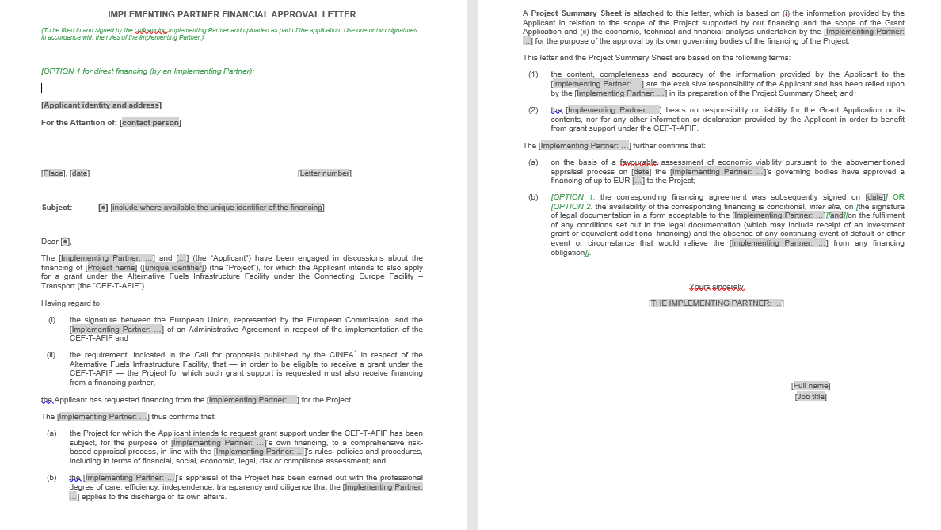
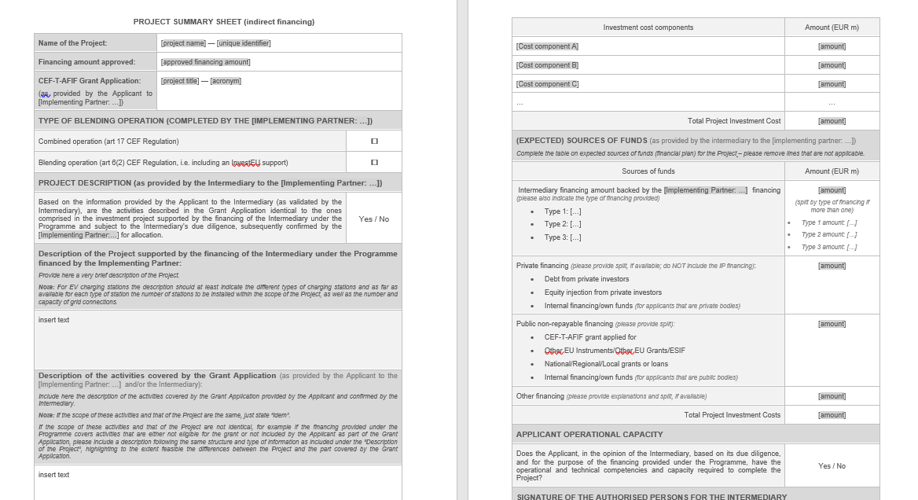
Applicable both to IPs and Non-IP:
Project financed by the IP/ Non-IP should incorporate / or / be equal to the Action eligible for funding under CEF AFIF. E.g.:
Minimum size of Financing : 10% of the total project investment costs (N/A to equity)
Form of financing: Loan, bonds, equity, guarantee
Financial Approval Letter including a Project Summary Sheet to be attached in the Application file
Project
Project
E-depot
E-buses
E-depot
CEF Action
CEF Action

Slide 22
Type of combinations
ART 6 BLENDING (up to half of GEN envelope) | ART 17 COMBINATION (At least half GEN envelope and full Cohesion envelope)
IP only | IP & Non-IP
Grant + IP Financing + InvestEU guarantee (Grant remains implemented in direct management by EC) | Grant + IP financing / or / Grant + Non-IP financing
optional
IP advantages
Alignment of interest and dialogue with EC
Advise and support project promoters (awareness raising & tailor made advice)
Minimum 2/3 of the AFIF budget
Possibility to blend with InvestEU financial product
Same advantages with IP intermediaries bound by an Intermediary framework loan with the IP
List of IP available soon with the call documents.

Slide 23
Sequences: financing / funding
IP / Non-IP approves the financing of the Project encompassing the Action
EC evaluates and awards the grant to the Action
IP / Non-IP signs the financial agreement of the Project encompassing the Action
EC signs the grant agreement of the Action
Step 1 | Cut-off date | xx/yy/zz
Step 2 | CEF committee vote | xx/yy/zz + 4 months | Notification from EC to Applicants and IPs that the CEF Committee has issued a positive opinion concerning the grant award
Step 3 | Selection decision adopted | xx/yy/zz + 5 months
Step 4 | Expected signing of the financing agreement by IPs | xx/yy/zz + max 8 months | Max 4 months after the notification in step 2
Step 5 | Maximal timing for EC to sign Grant agreement | xx/yy/zz + 9 months

Slide 24
Indicative timeline for signing FA & GA
 | Cut-of date | Date CEF Committee | Signature of the FA | MAX Date signature GA (TTG)
AFIF-1 | mer-19-janv-2022 | lun-09-mai-2022 |  | ven-21-oct-2022
AFIF-2 | mar-07-juin-2022 | jeu-13-oct-2022 |  | ven-10-mars-2023
AFIF-3 | jeu-10-nov-2022 | jeu-16-mars-2023 |  | ven-11-août-2023
AFIF-4 | jeu-13-avr-2023 | ven-28-juil-2023 |  | ven-12-janv-2024
AFIF-5 | mar-19-sept-2023 | ven-12-janv-2024 |  | ven-21-juin-2024
within 8 months

Slide 25

5. Timetables and deadlines
Timetable and deadlines (indicative)
Deadline for submission | 1st cut-off date | 2nd cut-off date | 3rd cut-off date | 4th cut-off date | 5th cut-off date
 | 19 January 2022 17:00 CET (Brussels) | 7 June 2022 17:00 CET (Brussels) | 10 November 2022 17:00 CET (Brussels) | 13 April 2023 17:00 CET (Brussels) | 19 September 2023 17:00 CET (Brussels)
Evaluation | February-March 2022 | July-August 2022 | December 2022 – January 2023 | May – June 2023 | October – November 2023
Information on evaluation results | May 2022 | October 2022 | March 2023 | July 2023 | January 2024
GA signature | September – October 2022 | February - March 2023 | July – August 2023 | December 2023 – January 2024 | May - June 2024

Slide 26
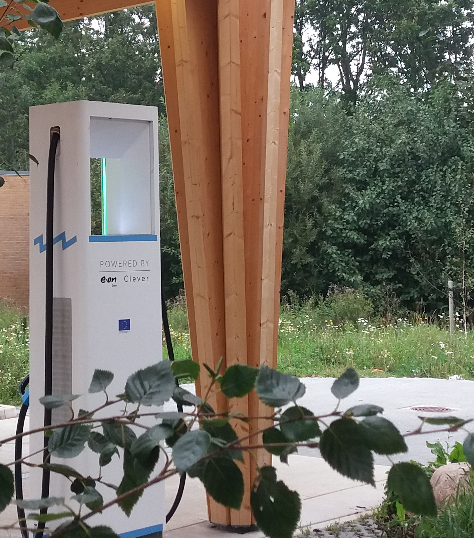
Thank you

